Slide 1
Gesture-Powered Snake Game with Computer Vision and Python
workshop
Anzhelika Kurnikova

Slide 2
Agenda
Overview
Pre Requirements
Coding
Conclusion
Next Events

Slide 3
Overview

Slide 4
Overview
In this workshop, we will:
- Learn how to download necessary packages to work with computer vision
- Learn how to apply a computer vision library “cvzone” to detect a hand and control a snake with it
- Code a snake game

Slide 5
What is Computer Vision?
Computer vision is a field of computer science that focuses on enabling computers to identify and understand objects and people in images and videos.
Examples:
- Self-driving cars
- Facial Recognition

Slide 6
Pre Requirements

Slide 7
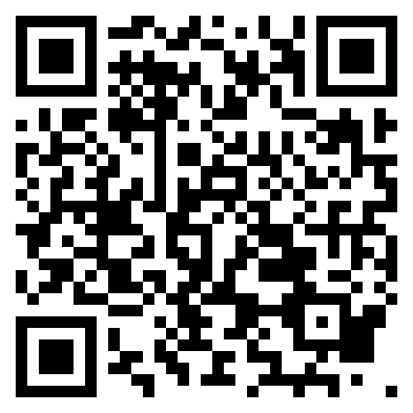
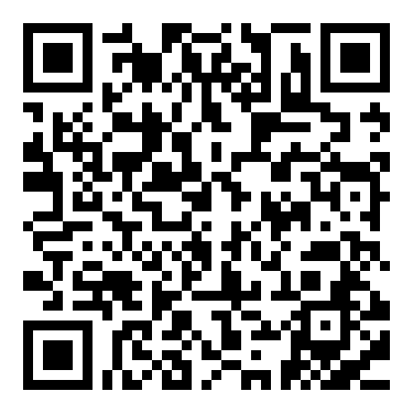
What to download and set up? Part 1.
1. Python, if you do not have it
https://www.python.org/downloads/
2. PyCharm Community Edition (it will simplify package installation)
https://www.jetbrains.com/pycharm/download/?section=windows

Slide 8
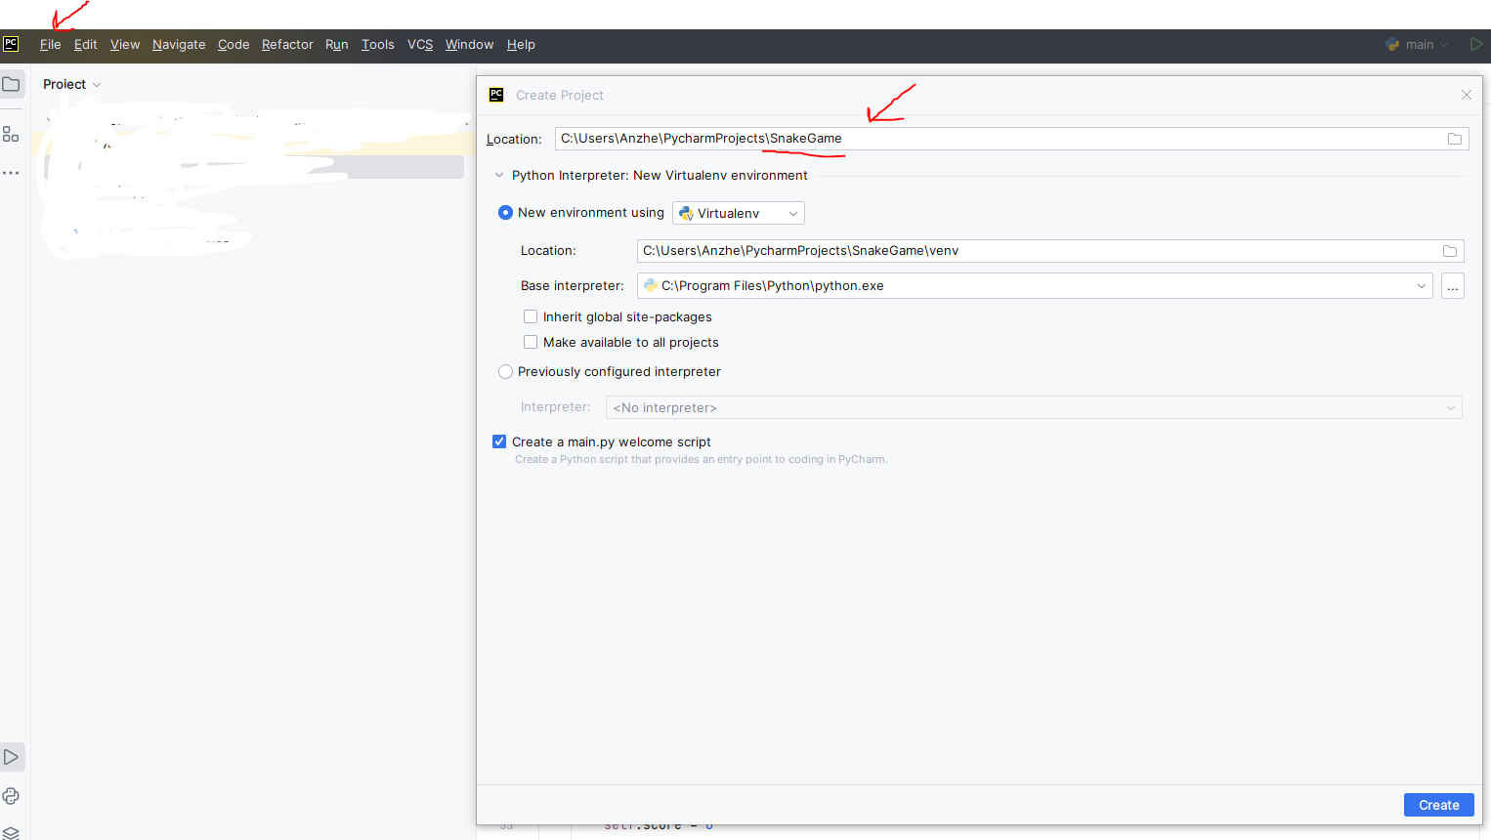
What to download and set up? Part 2.
3. In PyCharm, create a new project. Only change the Name.

Slide 9
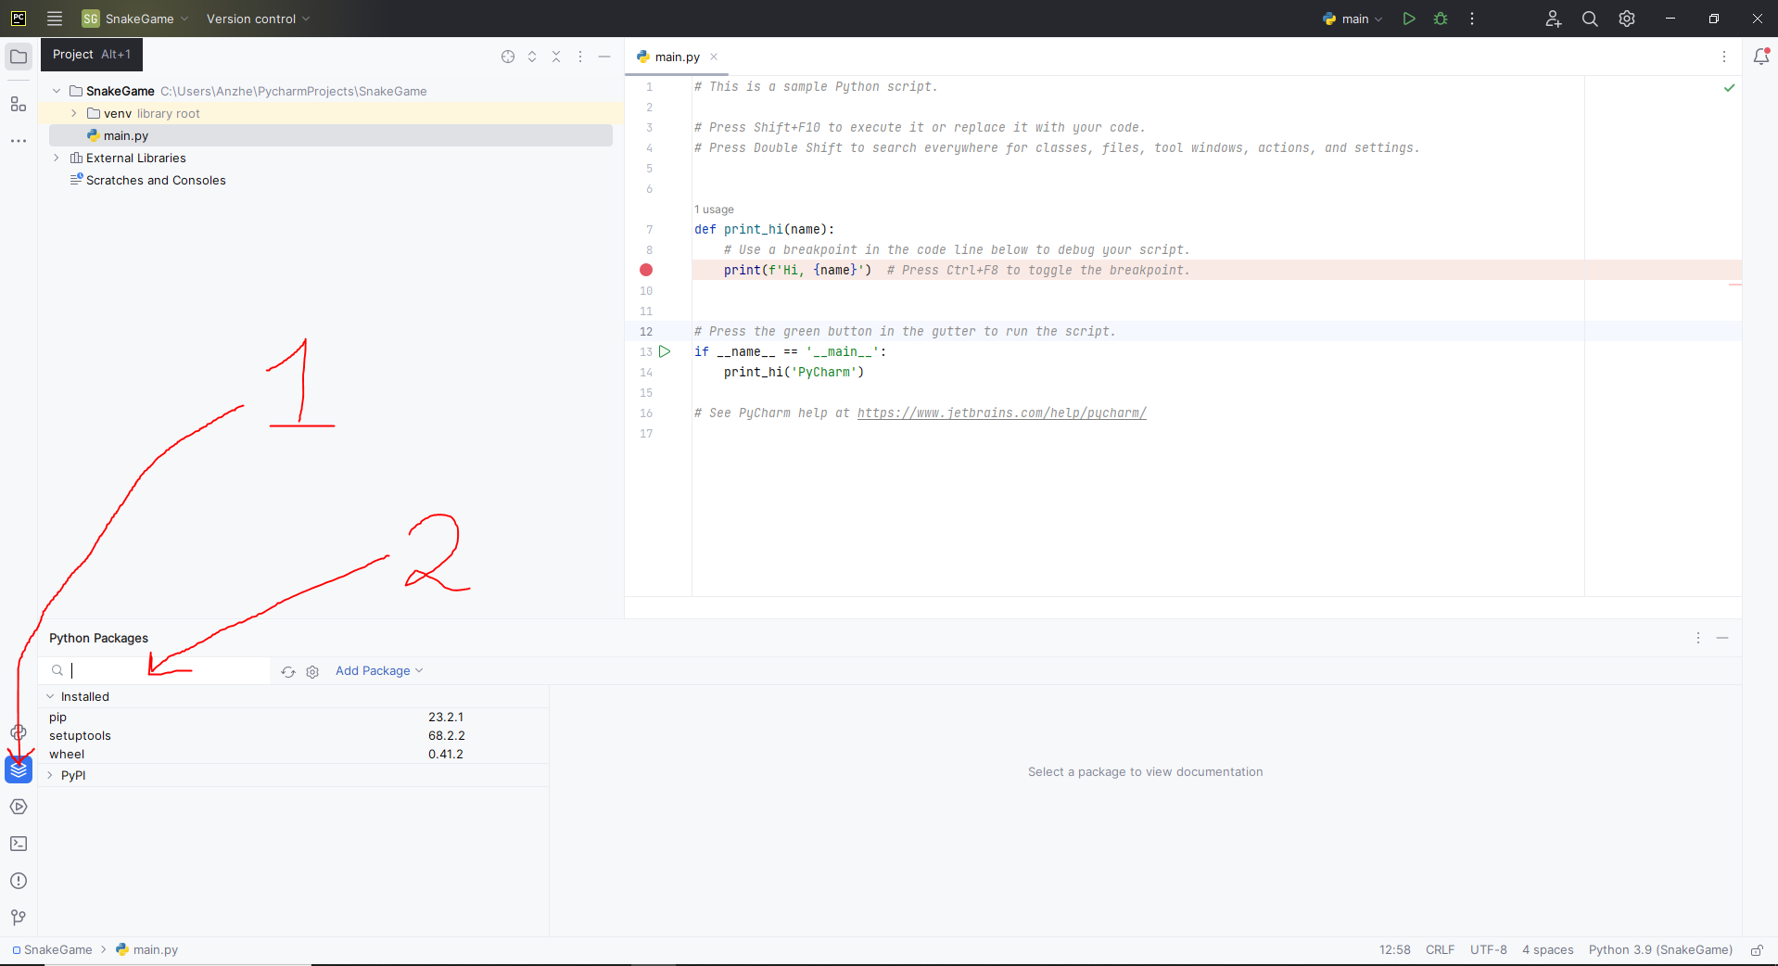
What to download and set up? Part 3.
3. Download latest versions of cvzone and mediapipe

Slide 10
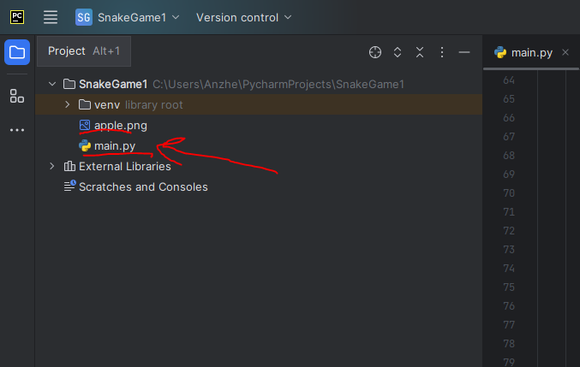
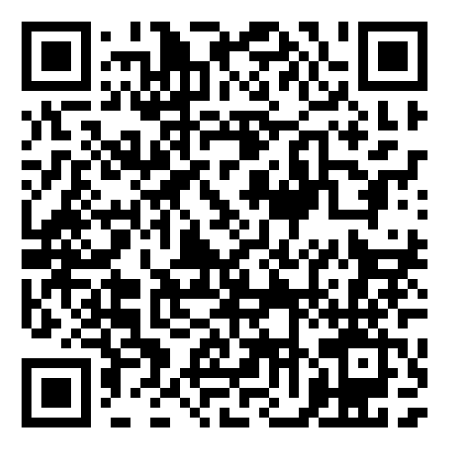
What to download and set up? Part 4.
3. Copy initial code from starter_code.py in main.py
Also copy the image of the apple.
https://github.com/USF-IEEE-Computer-Society/snake-game-computer-vision

Slide 11
Coding

Slide 12
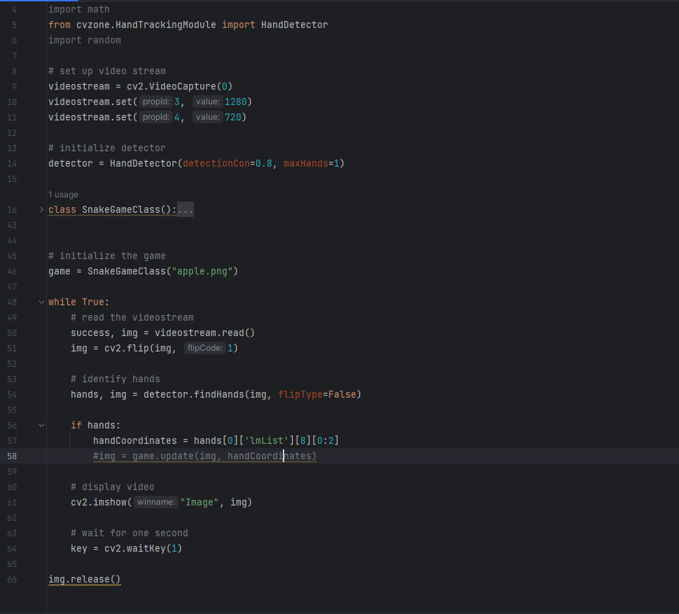
Part 1. Detecting a hand

Slide 13
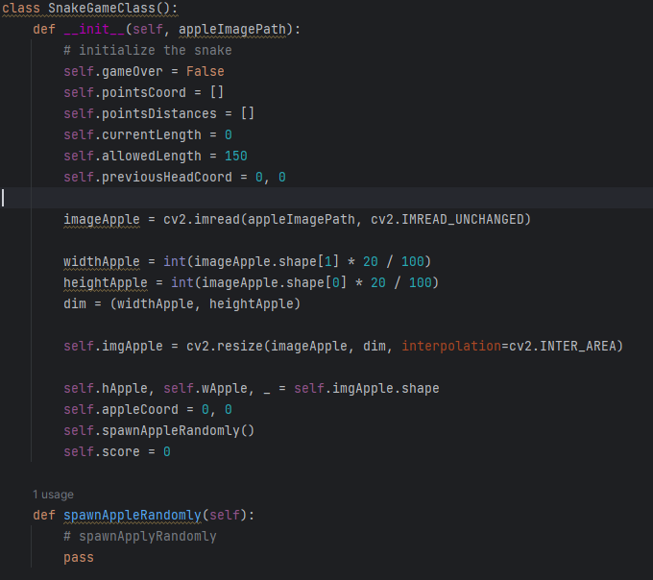
Part 2. Initializing the game

Slide 14
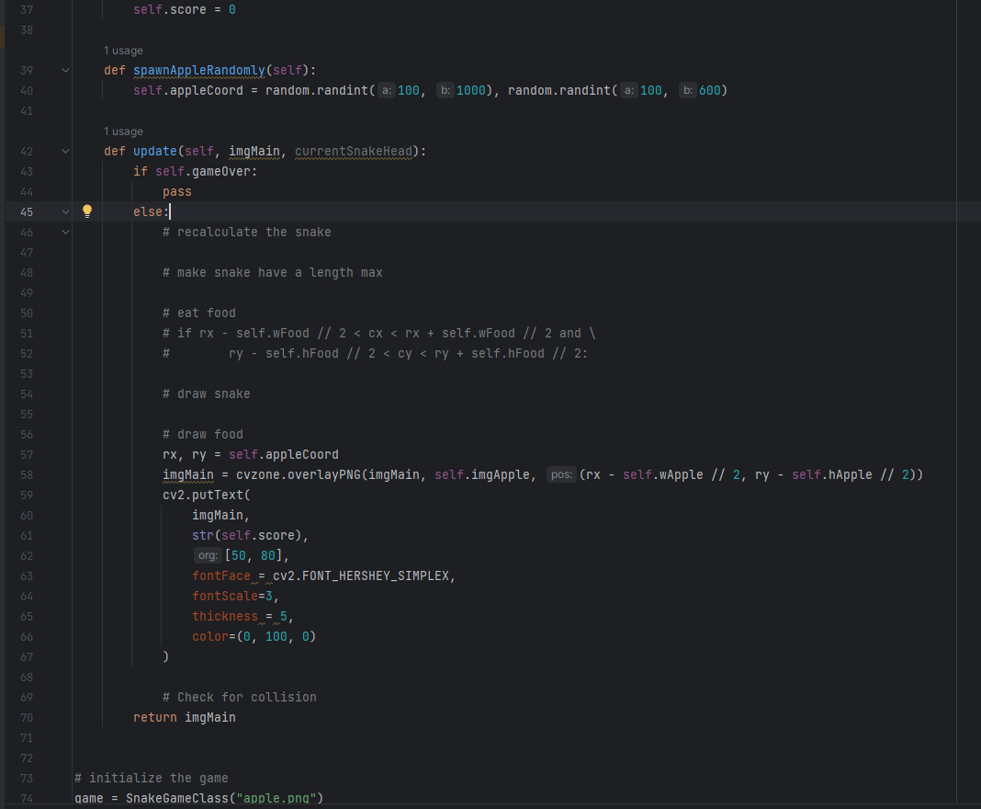
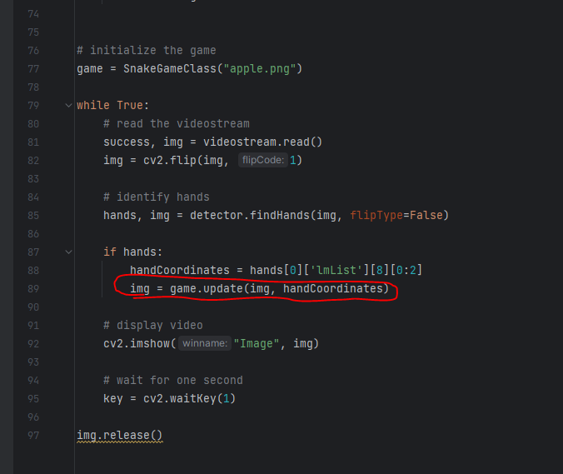
Part 3. Spawn apple

Slide 15
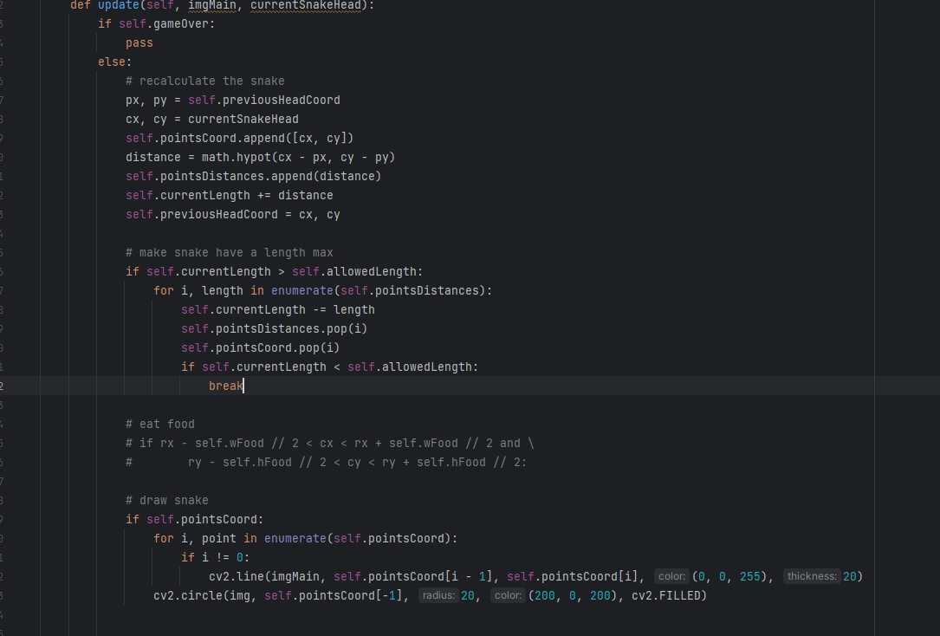
Part 4. Draw Snake

Slide 16
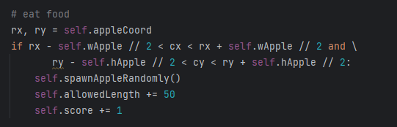
Part 5. Eat Food

Slide 17
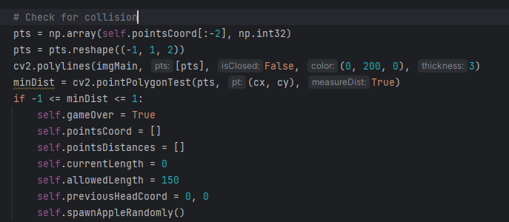
Part 6. Collision

Slide 18
Conclusion

Slide 19
Conclusion
We created a simple snake game empowered by computer vision.

Slide 20
Next Events

Slide 21
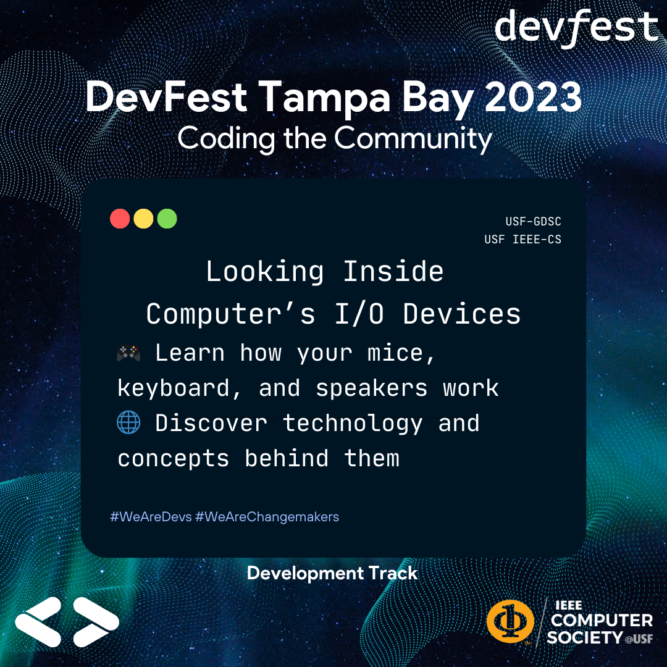
Next Events

Slide 22
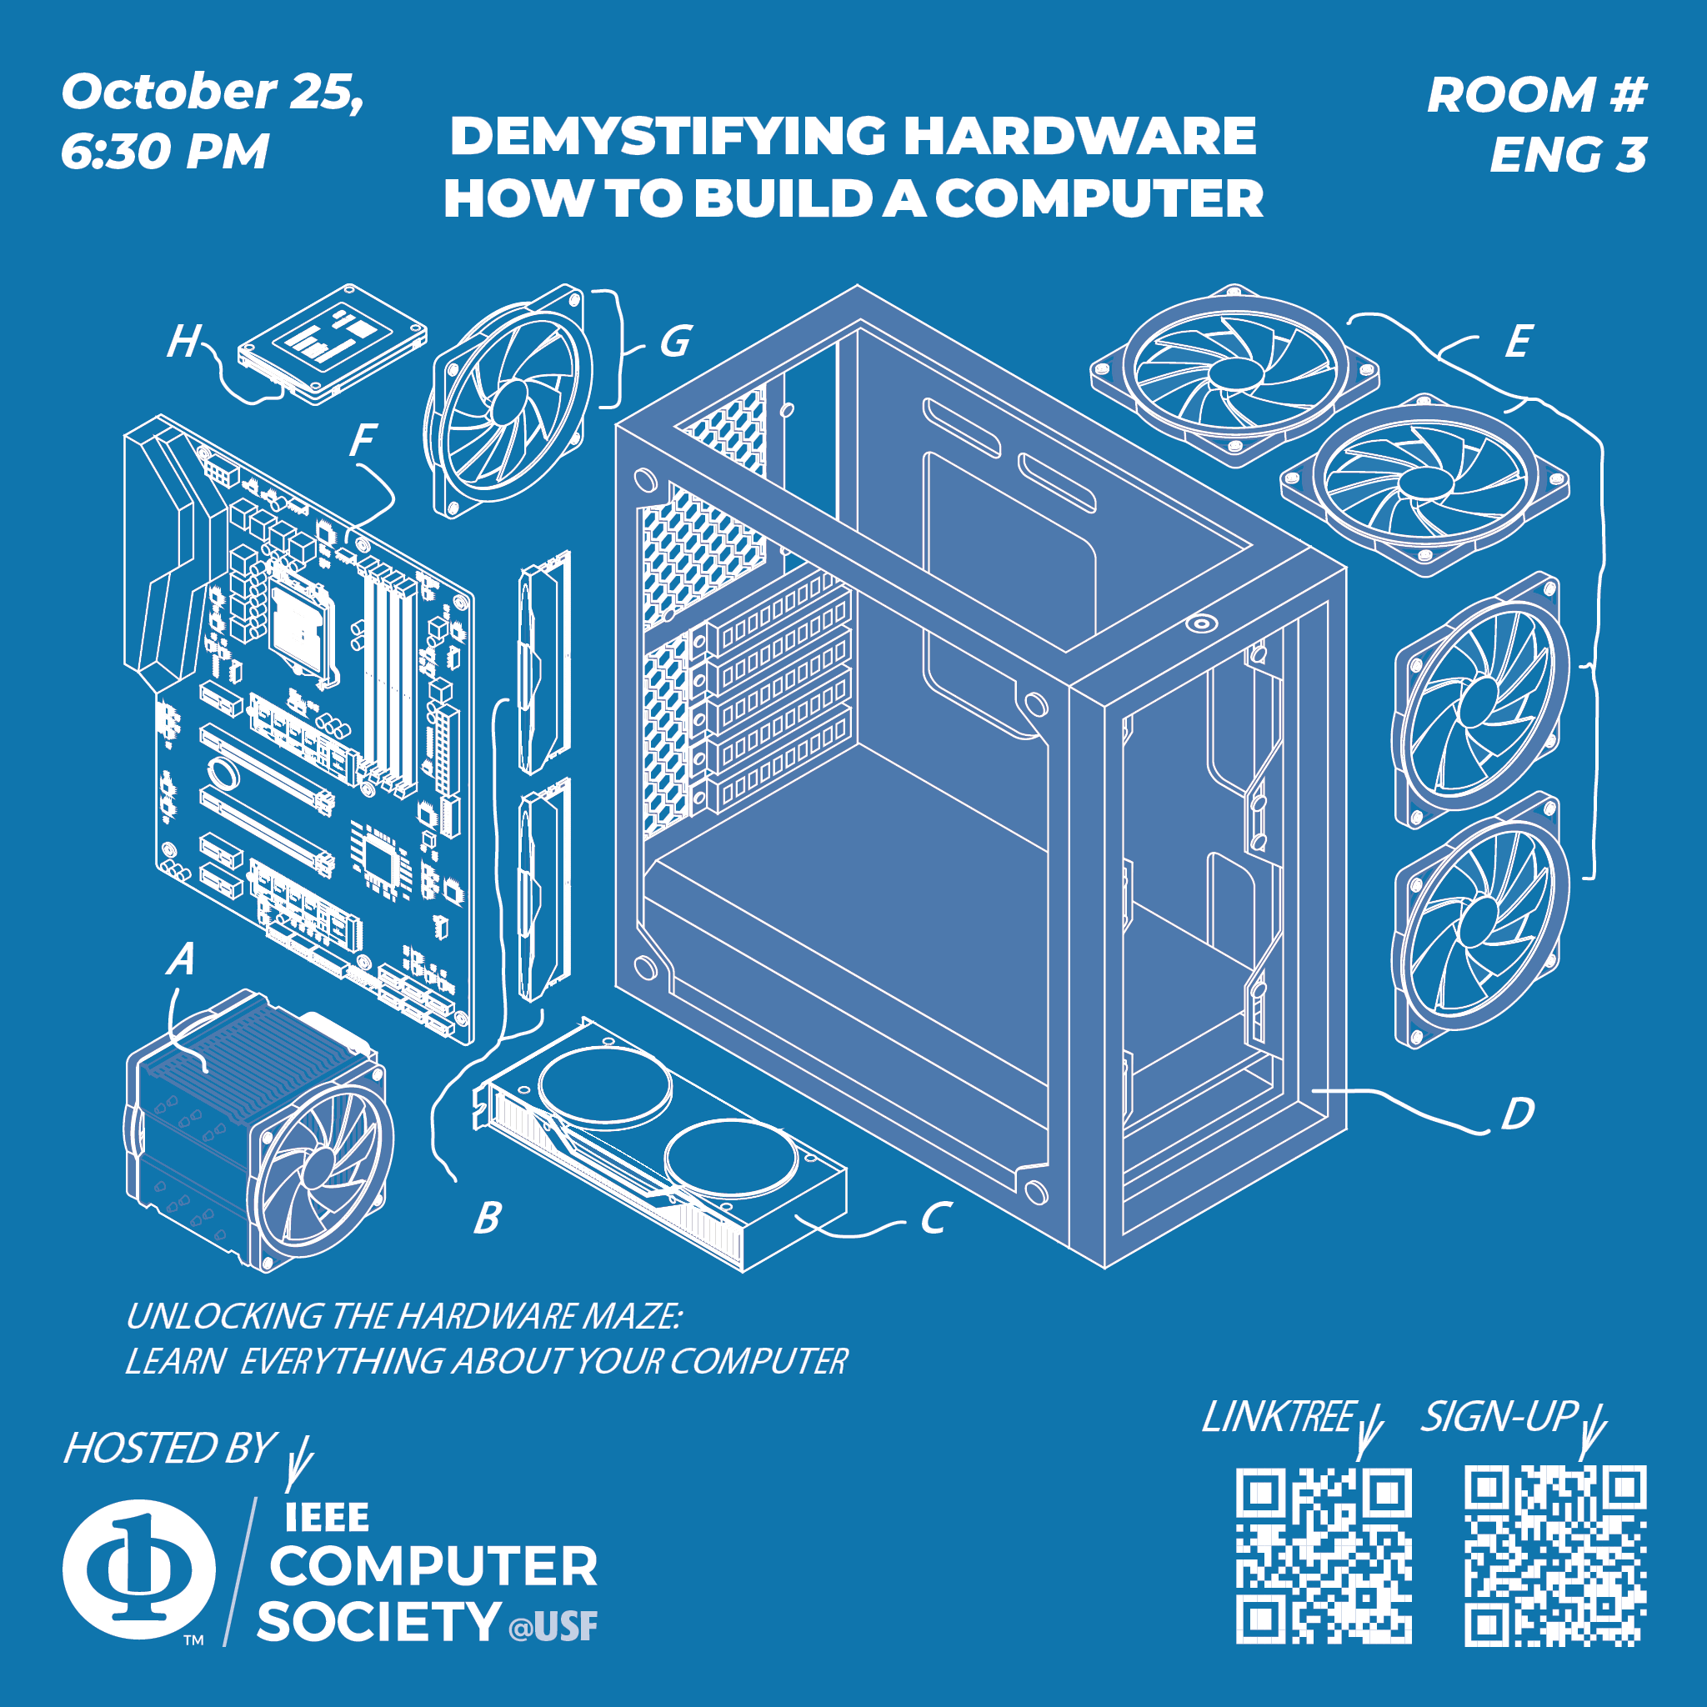
Next Events

Slide 23
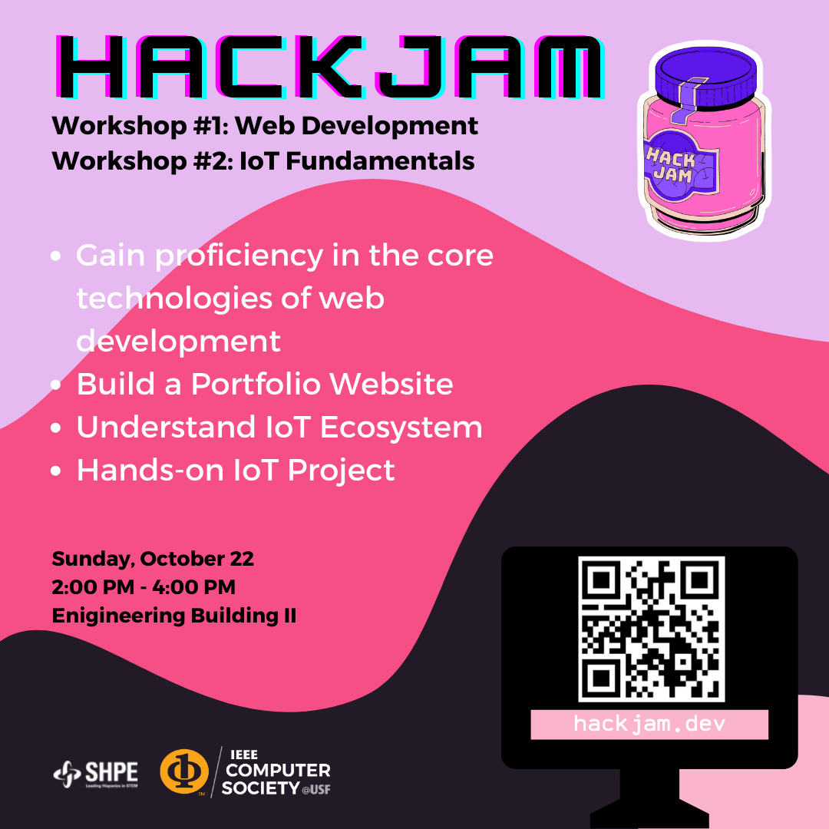
Next Events

Slide 24
References
CV Zone Documentation: https://github.com/cvzone/cvzone
Tutorials about CV Zone https://www.youtube.com/@murtazasworkshop

